Slide 1
Deprecated Functions – Identify Functions
AVCDL-Implementation-6.1.1
Charles Wilson
Staff Product Cybersecurity Architect
version 3
2026-03-17
Notes:
Script:
I'm Charles Wilson, staff product cybersecurity architect at Torc Robotics.
This presentation will cover the Deprecated Functions – Identify Functions activity.

Slide 2
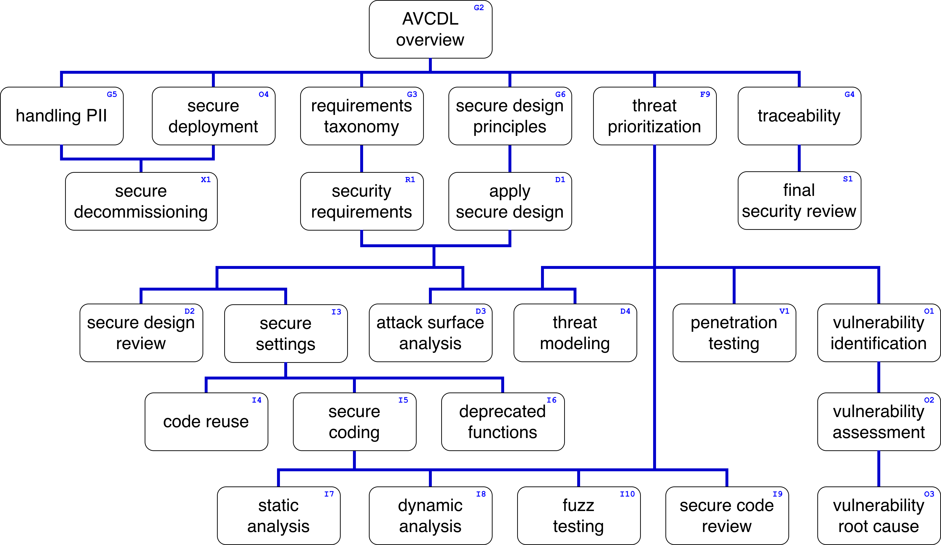
Training Path
Notes:
Script:
This diagram shows the overall AVCDL training path.
If you're taking this training, it's assumed that you've already completed the AVCDL Overview training,
and additionally, that you've completed the
Requirements Taxonomy
Security Requirements
Secure Design Principles
Apply Secure Design
and
Secure Settings
trainings.
This training will cover Deprecated Function Identification.

Slide 3
Workflow
Notes:
Script:
Before getting into deprecated function identification, let's briefly review where it fits, in the overall deprecated functions process.

Slide 4
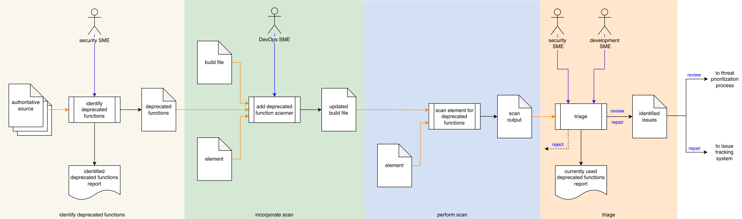
Process Workflow
Notes:
Script:
Here's the deprecated functions process which we previously covered in the Deprecated Functions Overview.
[break]
Our focus for this training is going to be on the first activity, that of function identification.

Slide 5
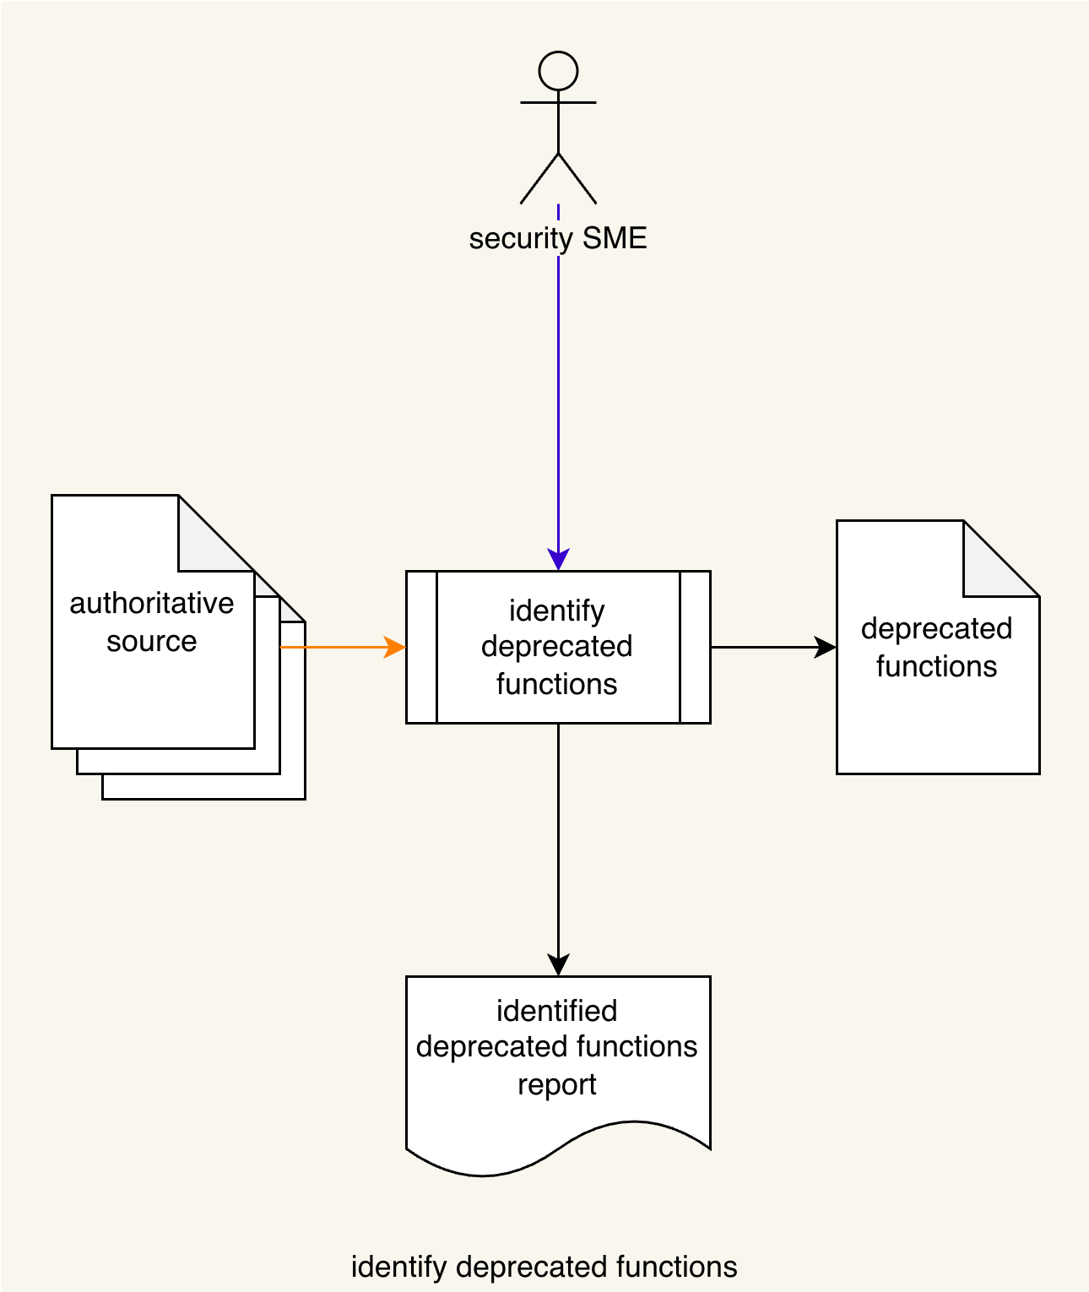
Process Workflow
Notes:
Script:
Here's the deprecated functions process which we previously covered in the Deprecated Functions Overview.
[break]
Our focus for this training is going to be on the first activity, that of function identification.

Slide 6
Identify Functions Activity
Notes:
Script:
Within the function identification activity,
[pause]
The cybersecurity SME, will review
[pause]
the authoritative sources, and
[pause]
identifies the deprecated functions called out in them.
[pause]
These will be compiled into a deprecated functions list.
From that list,
[pause]
an identified deprecated functions report will be created.

Slide 7
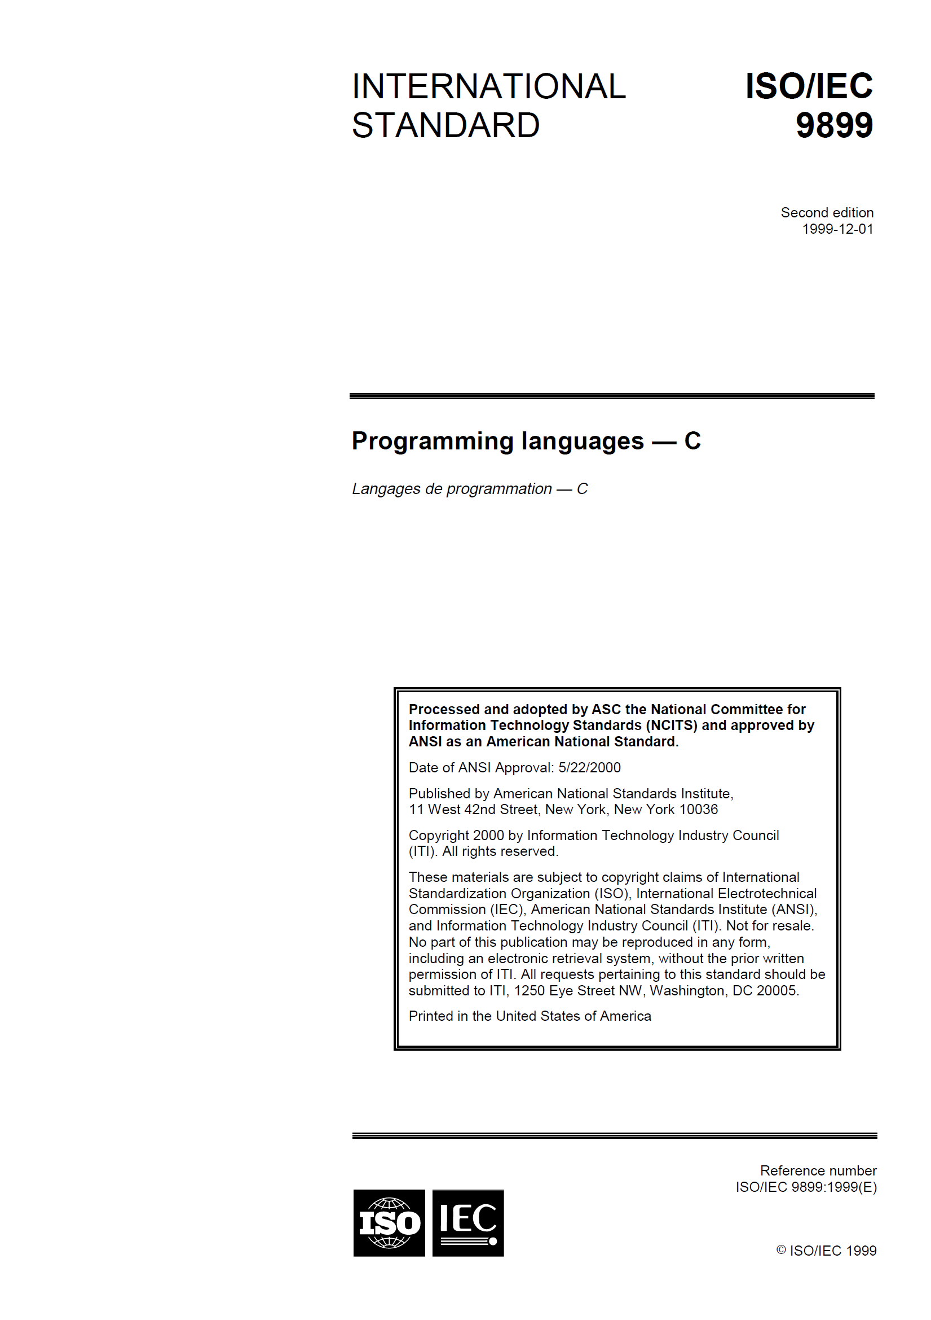
Authoritative Sources
Technical standards
Best practices
Industry recommendations
Notes:
Script:
An important aspect of dealing with deprecated, banned, unused, or functions which are otherwise inappropriate for use, is that of the authoritative sources used as the basis for identifying them.
These fall broadly into three groups.
This is not to say that these are the only sources where we're going to look, however, it's important to have, as with all things that we do in cybersecurity, appropriate traceability.
And, although they may be interesting, ephemeral sources are not, all that useful.
We want durable authoritative sources.
The first group we're going to consider is that of
[pause]
technical standards.
These are things which come from national and international bodies such as ISO, BSI, ANSI, or NIST.
[pause]
Here we see ISO/IEC 9899.
This is the standard for the C programming language.
Yes, there is a real written standard.
Within this standard is an annex which covers unsafe functions.
For our next group is that of
[pause]
best practices.
For our example here, we have
[pause]
the SDL List of Banned Functions from Intel for the C and C++ programming languages.
This list conveniently provides us alternatives to use, and we'll talk about that shortly.
Most large organizations which produce development software will have some publicly available set of guidelines that they use for doing software development covering various languages.
The third group is that of
[pause]
industry recommendations.
These are typically associated with lifecycles, providing restrictions on what versions of languages and the functions not appropriate for use within specific context.
[pause]
Here is MISRA C++:2023 Guideline for the use of C++17 in critical systems.
It’s typical of recommendation for safety-critical systems.
[pause]
From these sources we're going to extract the Information allows us to go from functions which are deprecated to ones which are more appropriate.

Slide 8
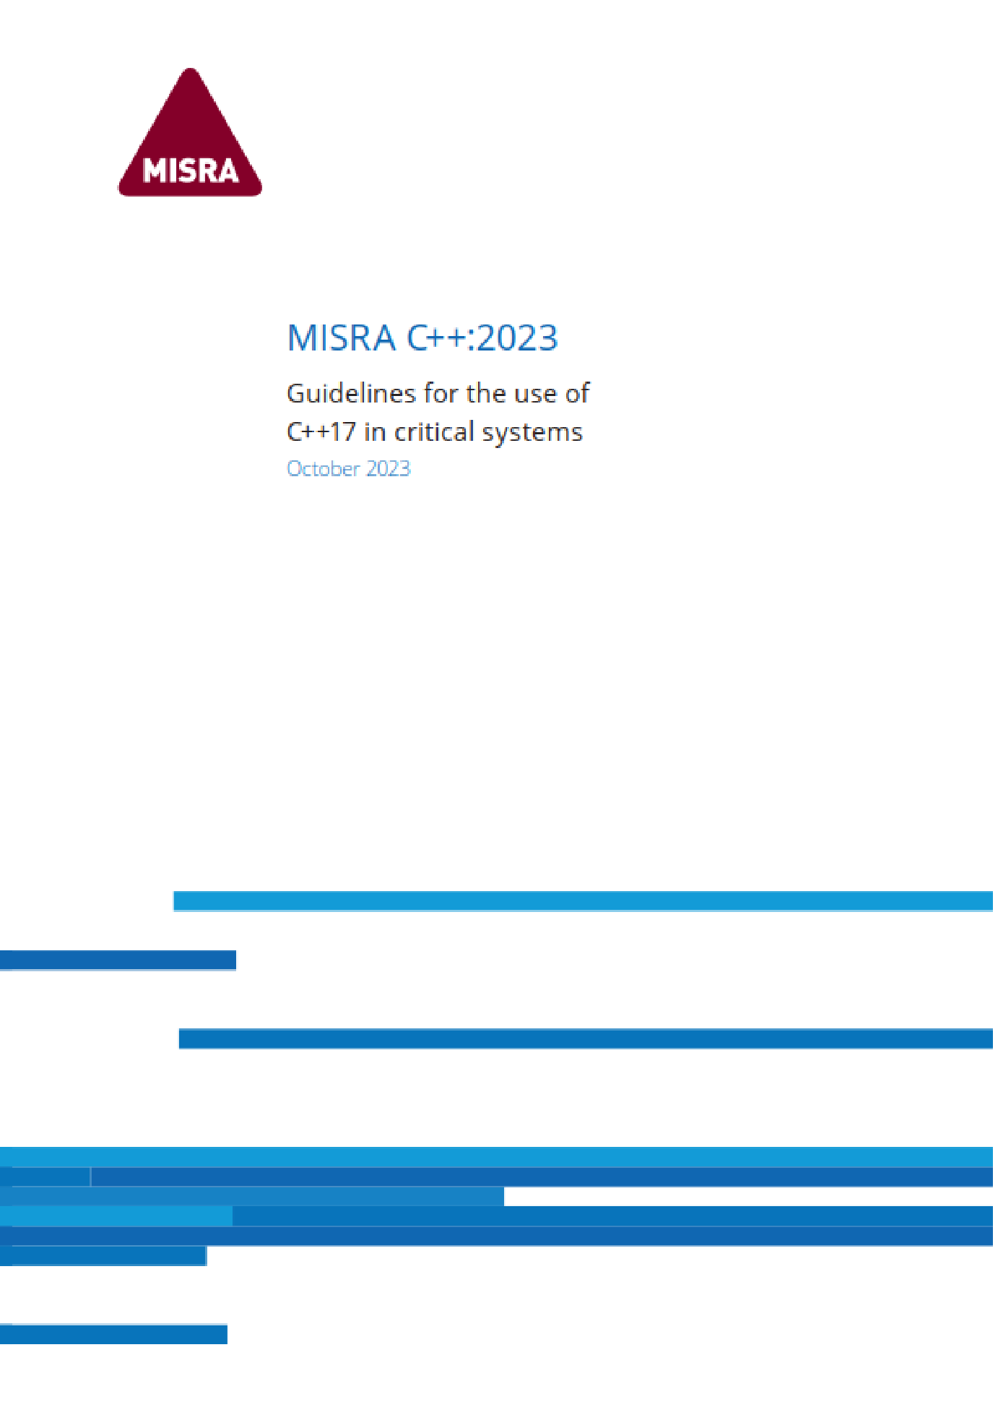
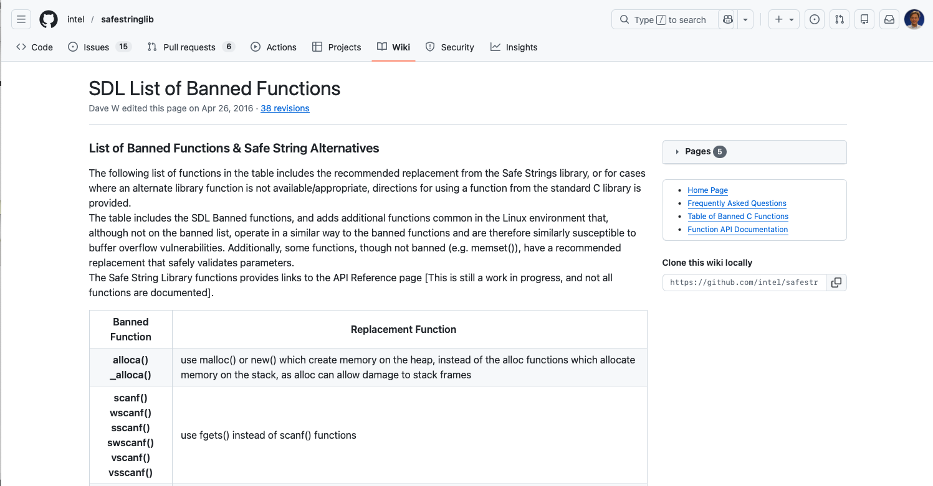
Notes:
overlay

Slide 9
Example
Notes:
Script:
Now let's work our way through an example of deprecated function identification.
We'll be using the AVCDL deprecated function catalog template which is described in the accompanying tertiary document that goes along with this training.
It's important to note here that this is just one mechanism for documenting this information.
There are any number of ways this information could be documented.
In an ideal world, you'd use a database to store this information across the various languages and platforms.

Slide 10
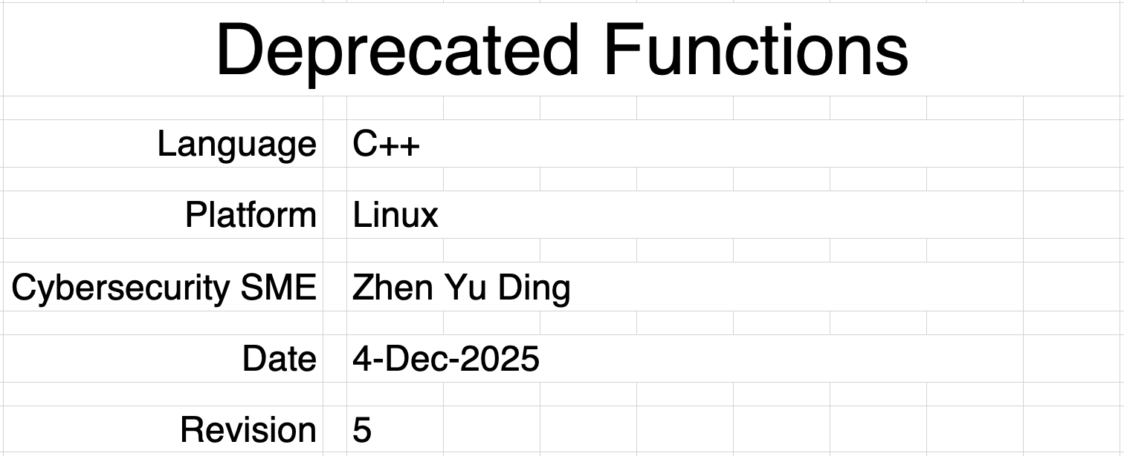
Cover Sheet
Notes:
Script:
In this example, we're going to look at
[pause]
the C++ language
[pause]
running on Linux.
Including the platform is important because there are going to be deprecated functions which may be operating system-specific.
There's no point calling out functions which don't have applicability to the operating system for the language that we're targeting.
This is especially true when we're looking at things like static analyzers, which may be able to take the deprecated function list, and scan for it.
So, if we're only targeting Linux, but looking for deprecated Windows function calls, all we're doing is consuming resources and time.
Next, we have
[pause]
the cybersecurity SME who has performed this activity.
[pause]
the date
[pause]
And the revision, which (as a reminder) is a monotonically increasing number.

Slide 11
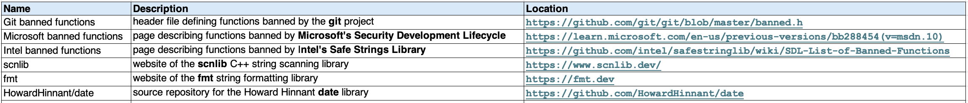
References Sheet
Notes:
Script:
Next, and arguably one of the most important things to document is the references that were used to compiler the authoritative sources and their replacements.
We capture three pieces of information.
The first is
[pause]
the name of the source.
[pause]
The next is
[pause]
its description.
This is included because the name isn’t always sufficiently clear.
[pause]
Finally, is
[pause]
its location.
This information points us back to why we may have to revise this document.
For some sources, the location won’t be subject to change.
Other times, such as when pointing into repositories, things may move, and you need to update the location information.
[pause]
The first three entries are authoritative sources.
[pause]
Looking at
[pause]
The Microsoft banned functions, a page describing the banned Microsoft security development lifecycle functions and includes its location.
Similarly, with
[pause]
the Intel banned functions.
[pause]
The last three entries are references to the replacements for those deprecated functions.
It's just as important to provide references to the replacements as to the authoritative sources, because you need to know where to look to find the pieces that you're going to be replacing things with.
It’s not sufficient to just collect a list of what’s deprecated.

Slide 12
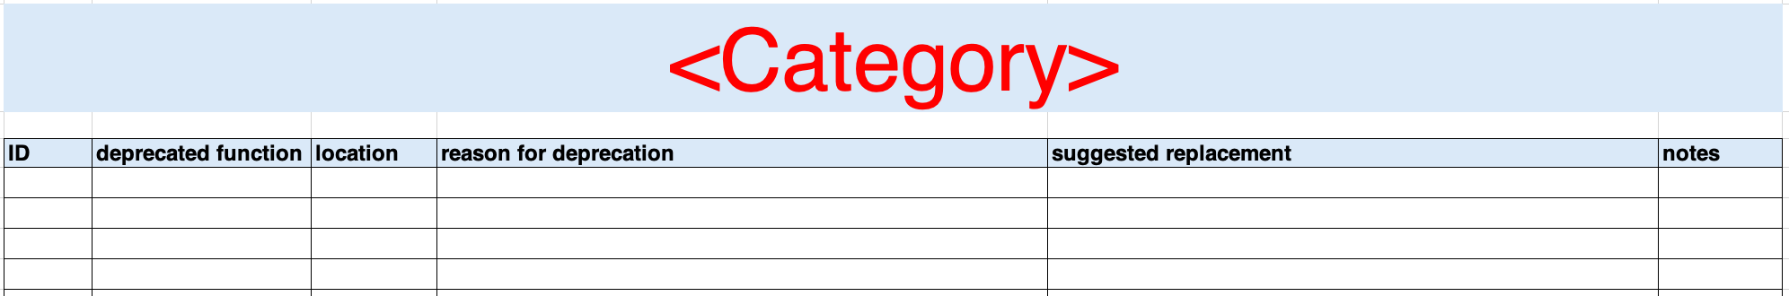
Deprecated Functions
Format
Memory
Strings
Time
Notes:
Script:
Now let's move on to the deprecated functions themselves.
In the template that's provided is a category sheet.
The intent is that you either rename it to deprecated functions and put all the functions there or create separate sheet grouping like functions into categories and renaming the sheet appropriately.
In the case of the example that we're using, within the context of C++, four categories were used.
These are
• formatting
• memory management
• string handling
and
• time-related functions
Let's look at one of these in detail.

Slide 13
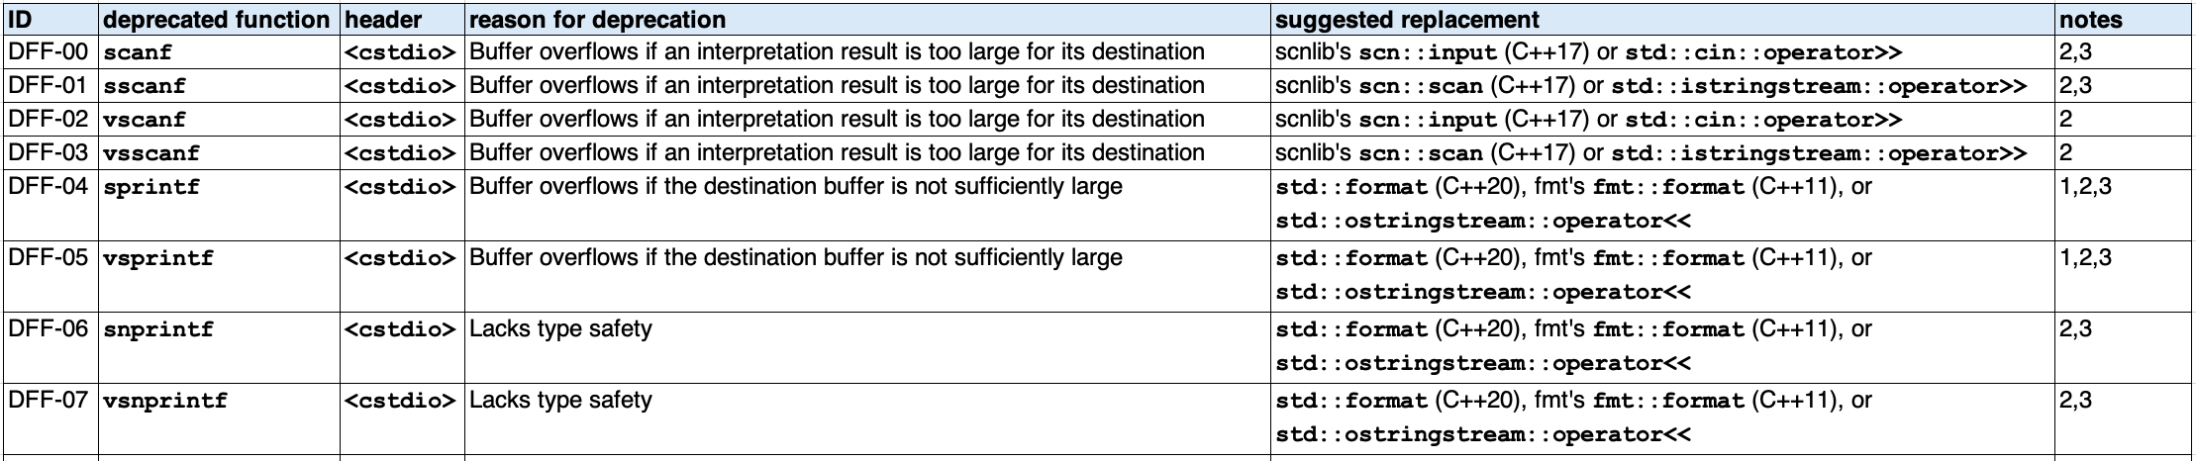
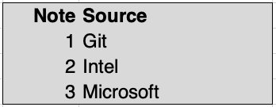
Deprecated Functions – Formatting Sheet
Notes:
Script:
The formatting sheet of our example shows the typical way that we're going to be recording the deprecated function information.
We're going to have
[pause]
a unique identifier for each of the functions identified.
[pause]
the deprecated function's name.
[pause]
The header that it is in.
[pause]
The reason for the deprecation, and this is really important.
It's a critical to provide why this needs to be replaced.
Next is the most critical column, and that is
[pause]
the suggested replacement.
It's not enough to say that this function is bad for whatever reason, whether it's that the feature of the language has been removed, that the function is considered unsafe, whatever the rationale behind it is.
Having a means to replace it that's clear is really important.
[pause]
And finally,
[pause]
a notes column.
The functions within this category fall into two buckets.
The first are
[pause]
those related to input.
And the second are
[pause]
those related to output.
As you can see,
[pause]
the reason for deprecation for those related to input are all the same, and that's to be expected since the functions are in a family.
[pause]
We also have similar reasons for deprecation for the functions which are related to output.
[pause]
Looking at the suggested replacements.
One of the key things that we have here is that we're not just considering the latest and greatest version of the language that we're dealing with.
In languages like C++, which have been around for decades, there's a lot of growth that has occurred and because of that, over time, limitations that were recognized have been addressed in different ways.
As we can see here
[pause]
with DFF-05, the vs-print-f issue,
[pause]
our suggested replacement when we're dealing
[pause]
with C++20 and later, is standard format.
If all we have
[pause]
is C++11 or later, then we're going to recommend the format library that eventually became standard format.
And otherwise,
[pause]
we're recommending that an o-string-stream be used.
It's important to recognize that not all replacements are going to be equal, and that sometimes, as in the case of standard format versus streams, there is going to be a distinction in performance and other characteristics.
This is a trade-off that has to be made by the development teams based on the criticality of the code.
Sometimes there is no fast and safe alternative to a function that needs to be replaced.
Now, Let's look at
[pause]
the notes column.
As you see, they're just numerics.
What we've done within this example is
[pause]
provide references to the authoritative sources, so that people can look them up.
As we can see here, these are sourced from multiple locations.
Additionally, since they're provided in the references, you could provide notes that tells you which reference is used as a basis for the suggested replacement.
In this example, the sources of the suggested replacements are unambiguous.
With the deprecated functions, we don't know where they’re being sourced from unless we include a reference.
The same treatment was applied to the other three categories mentioned.

Slide 14
Recap
Notes:
Script:
That covers deprecated function identification.
Let’s review some of the important points.

Slide 15
Summary
Single language / platform
Document authoritative sources
Provide clear reasoning
Consider solution alternatives
Identify references
Generate human-readable report
Notes:
Script:
When identifying deprecated functions
[pause]
focus on a single language on a single platform.
[pause]
Document the authoritative sources.
[pause]
Provide clear reasoning as to why the function should be replaced.
[pause]
Consider solution alternatives for variants of language and configuration.
[pause]
Identify where the particular deprecated function is being sourced from.
[pause]
And generate a human-readable report when it's all done.
That way you'll have a summary of all of the actions that you need to take.

Slide 16
Example Materials
<AVCDL>/distribution/reference_documents/working_material/deprecated functions/
Notes:
Script:
The materials that were used to cover this example are in the location shown here.
It's important to note that the workbook includes all the sheets covered in this training.

Slide 17
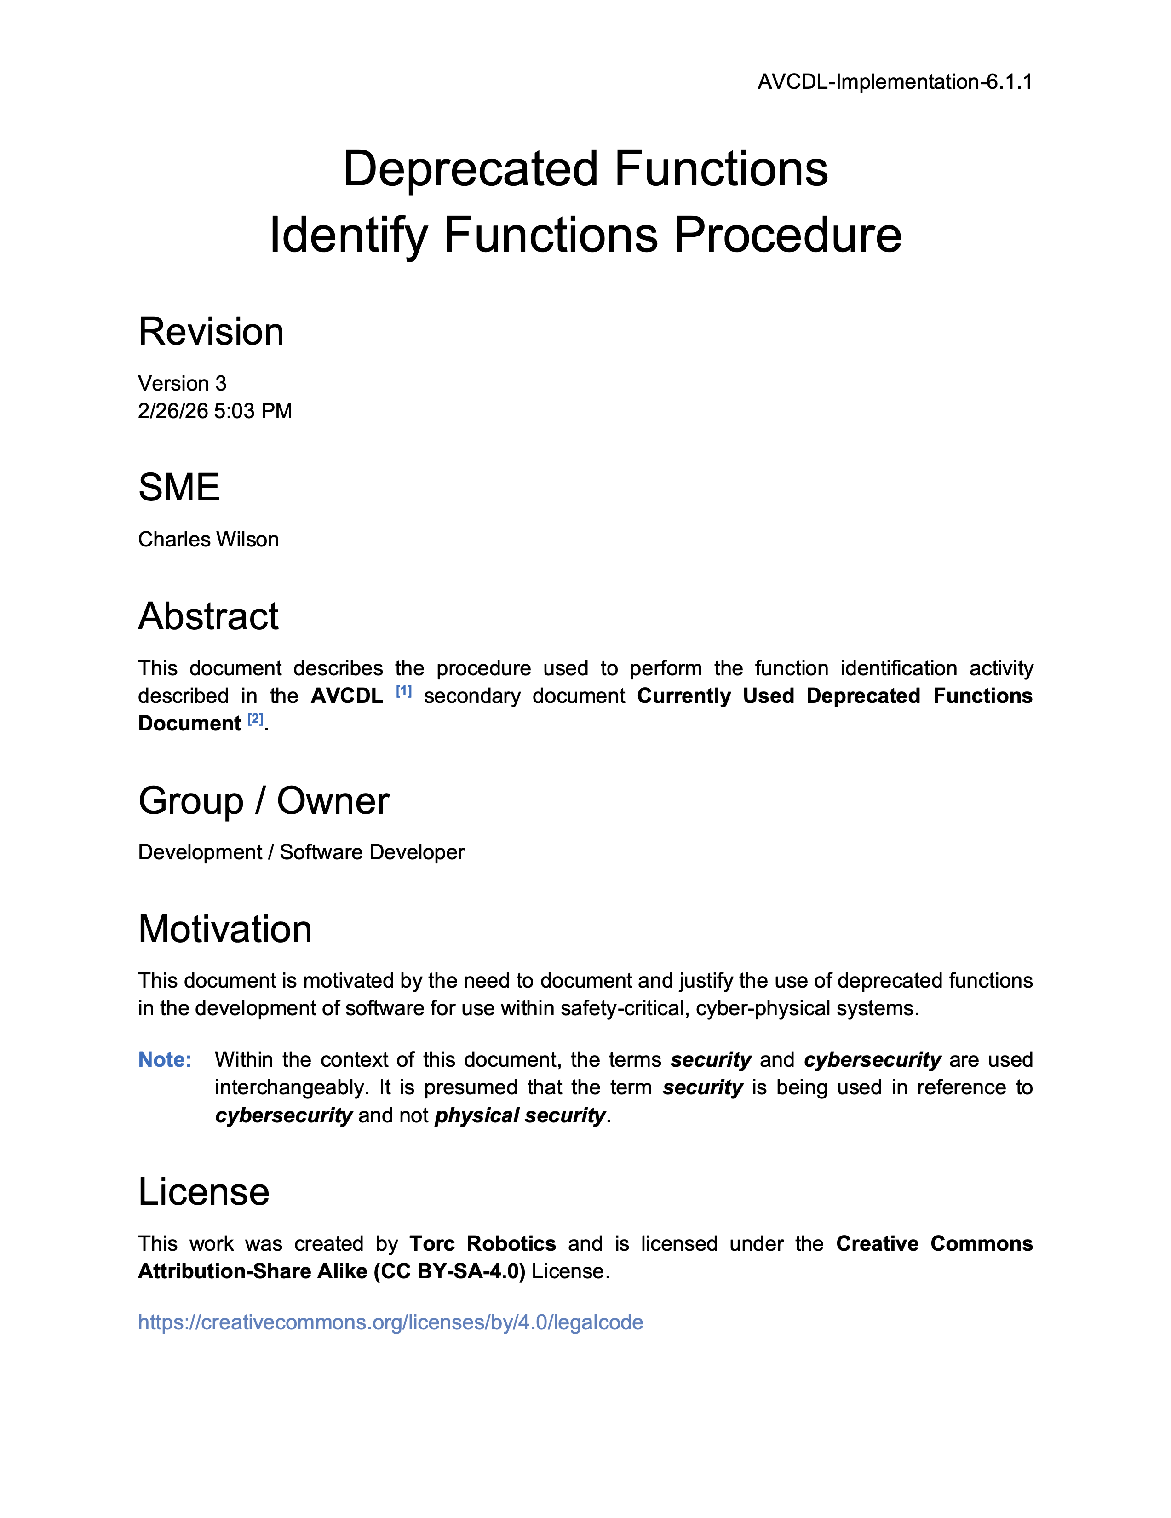
Further Reading
Notes:
Script:
For additional information and to get a more in-depth set of references, the Deprecated Functions Identify Functions Procedure tertiary document is available in the AVCDL GitHub repository.

Slide 18
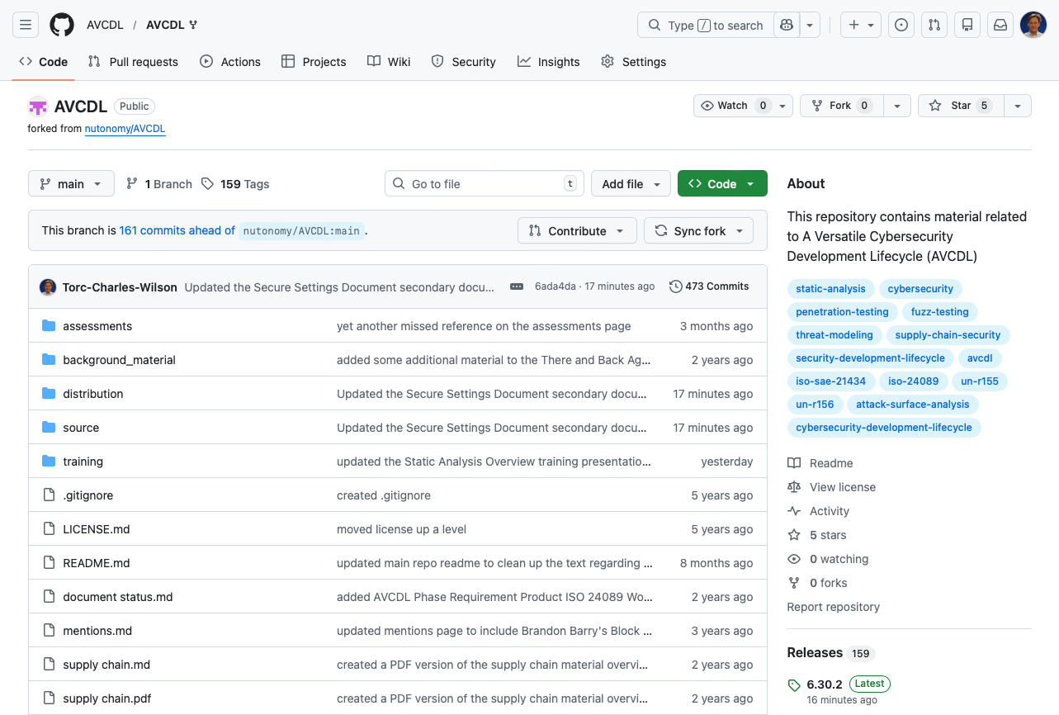
AVCDL on GitHub
https://github.com/AVCDL/AVCDL
Notes:
Script:
All AVCDL materials, both in source and distribution forms, are available on our GitHub site, as shown here.
Because of the size of the repository, it's recommended that you either clone the repository or download a ZIP archive of it, if you're not familiar with using git.
Instructions for downloading a ZIP archive are linked to on the repository’s front page.

Slide 19
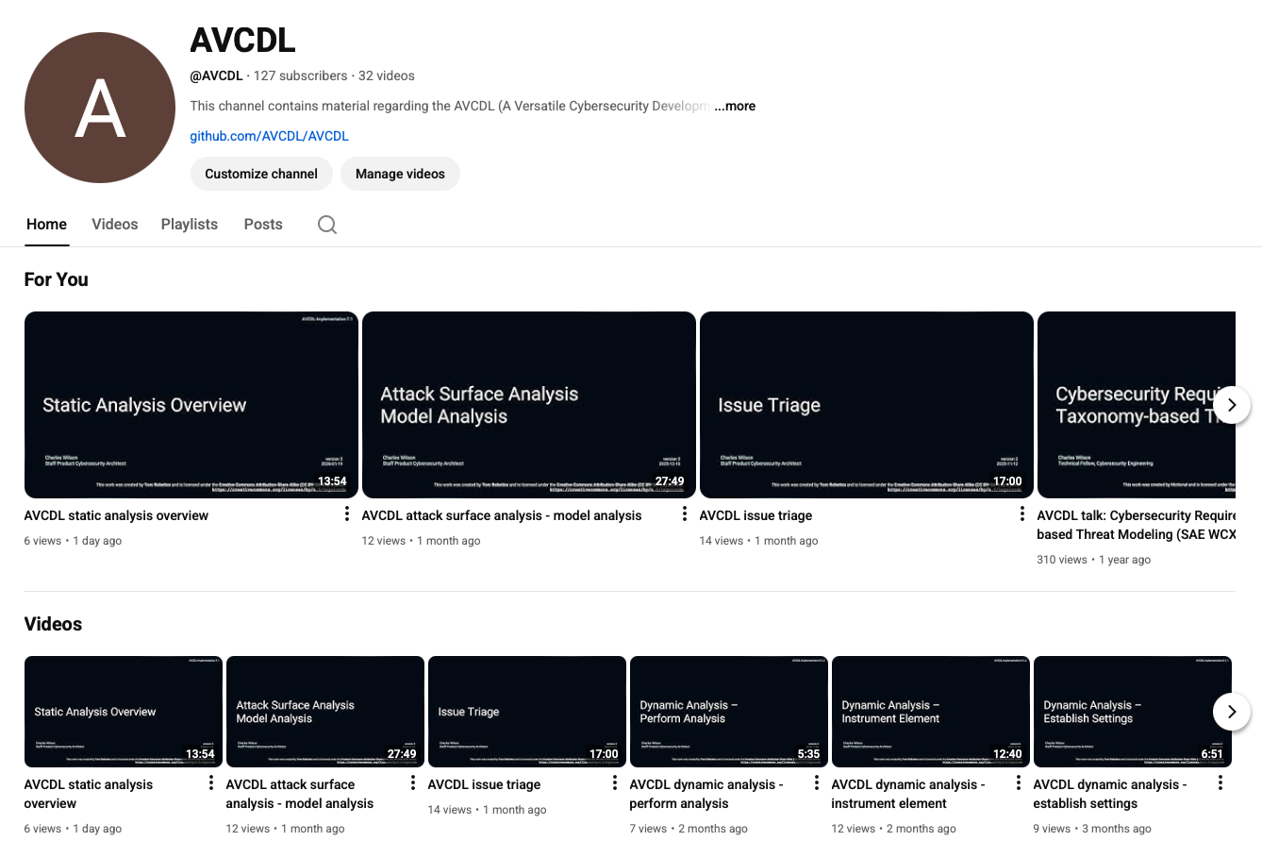
AVCDL on YouTube
https://youtube.com/@AVCDL
Notes:
Script:
Videos covering various aspects of the AVCDL are available on our YouTube channel, as shown here.
It's important to note that all AVCDL materials with the exception of the introductory blog posts are intended for product cybersecurity engineering practitioners.

Slide 20
Next Steps
Notes:
Script:
With this training complete, if you’ve completed the other trainings covering the Deprecated Functions process activities, you can proceed to the other trainings at this level, these include:
Core Reuse
and
Secure Coding

Slide 21
References
AVCDL primary document
Currently Used Deprecated Functions Document (AVCDL secondary document)
AVCDL deprecated functions catalog template (AVCDL template)
Report Generation (AVCDL elaboration document)
ISO/IEC 9899-1999 cover (public domain)
https://commons.wikimedia.org/wiki/File:ISO-IEC-9899-1999-cover.png
MISRA C++:2023 cover
https://misra.org.uk/app/uploads/2023/11/Misra_CPP-2023.png
SDL List of Banned Functions
https://github.com/intel/safestringlib/wiki/SDL-List-of-Banned-Functions
Notes:
Script:
Here are the references to the source material used in the creation of this presentation.
They'll also be included in the video description.
Additionally, this presentation’s source material will be provided on the AVCDL GitHub repository.

